Slide 1
Chapter 12
Enhancing a Document

Slide 2
Learning Objectives
Create and modify tables
Change the page orientation
Divide a document into sections
Insert and modify graphics
Add WordArt
Wrap text around graphics
Work with columns
Work with building blocks

Slide 3
Enhancing a Document
Word documents can contain much more than text.
Elements such as tables, illustrations, graphical headlines, and formatted headings can be used to enhance documents.
Some documents are formatted in multiple columns.
Other documents have decorative borders around the entire page.

Slide 4
Organizing Information in Tables
A table is a grid of horizontal rows and vertical columns.
Topics Covered:
Creating a Table
Entering Data in a Table
Selecting Parts of a Table
Inserting a Row or Column
Deleting a Row or Column
Changing Column Widths
Formatting Tables with Table Styles
Aligning Tables and Text in Tables

Slide 5
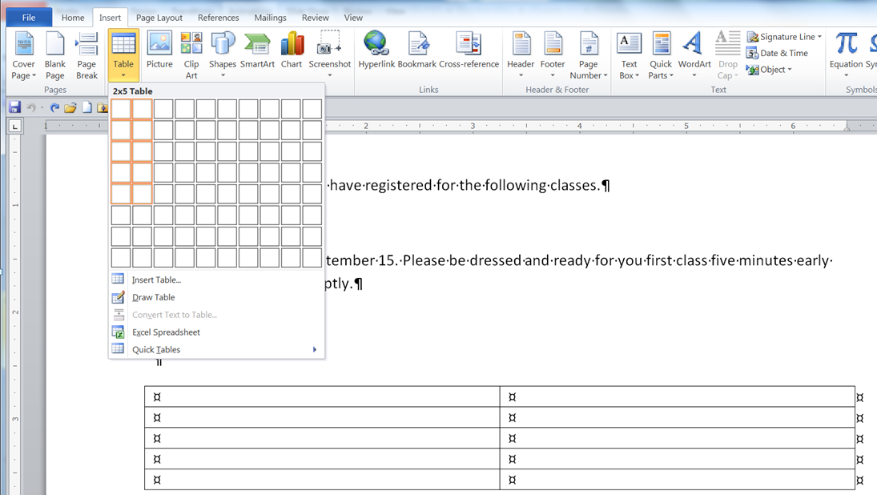
Creating a Table
Table Button on
Insert Menu
Table
Size
Selected cells indicate
the table structure
Live preview of the table
in the document

Slide 6
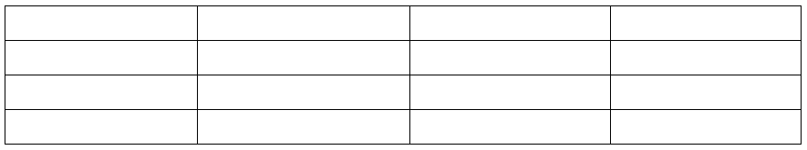
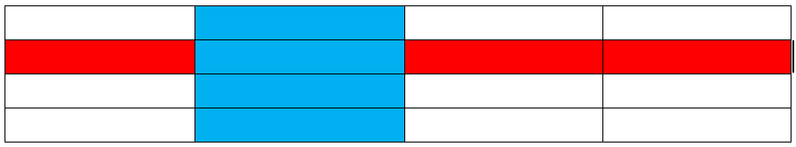
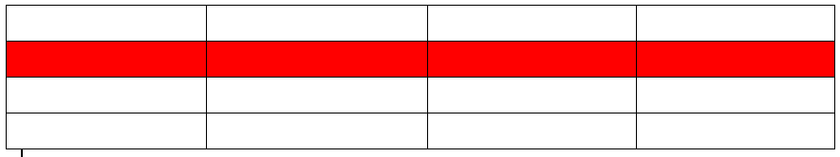
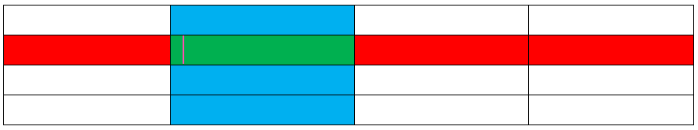
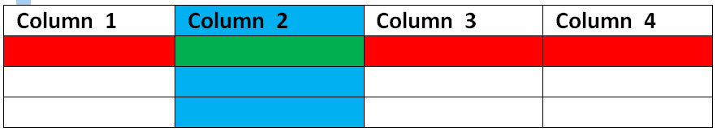
Creating a Table
Tables are organized into
columns
and rows.
The box at the intersection of a column and a row is a cell.
The row at the top of the table that contains names is called the header row.

Slide 7
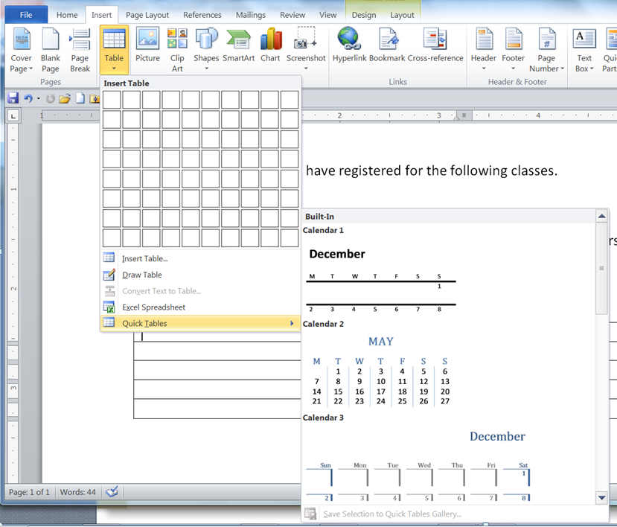
Creating a Table
A Quick Table is a table template with sample text and formatting.

Slide 8
Entering Data in a Table
To enter data in a table, simply move the insertion point to a cell and type.
You can move the insertion point to a cell by clicking in that cell or use the keyboard to move the insertion point between cells.
To move to the next cell to the right, press the Tab key.
To move to the next cell to the left, press the Shift+Tab keys or the arrow keys.
A new row will appears at the bottom of your table, if you pressed the Tab key when the insertion point was in the last cell in the table.
To remove that unwanted row go to the Quick Access Toolbar, click the Undo button to remove the extra row from the table.

Slide 9
Selecting Parts of a Table
You can select a cell, a row or column, multiple rows or columns, or the entire cell.
To select parts of a table from the Ribbon, with the insertion point positioned in a cell, click the Select button in the Table group on the Table Tools Layout tab, and then click the appropriate command.

Slide 10
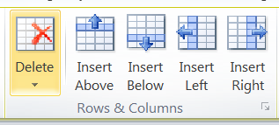
Inserting a Row or Column
You can modify the structure of a table by adding or removing rows and columns.
You use the Rows & Columns group on the Table Tools layout tab.
To delete the contents of a cell, row, column, or table, select the parts of the table containing the contents you want to delete, and then press the Delete key.

Slide 11
Changing Column Widths
You can change a column’s width by dragging the column’s right border to a new position.
You can double-click a column border to make the column width adjust automatically to accommodate the widest entry in the column.
Position the cursor over the line between the two columns, the double-headed arrow will appear, then double click.

Slide 12
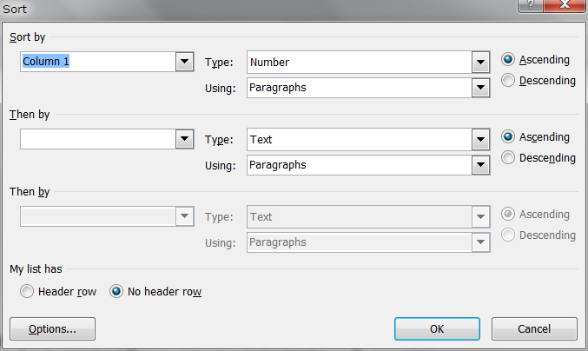

Sorting Rows in a Table
You can sort a table based on the contents of one of the columns in alphabetical, numerical, or chronological order.
You can sort a table based on the contents of one of the columns.
Alphabetical
Numerical
Chronological
Ascending
Descending

Slide 13
Formatting Tables with Table Styles
Word includes a variety of built-in styles that you can use to add borders, shading, and color to tables.
Banded rows (banded columns): Formatting that displays alternate rows (or columns) in a table with different fill colors.

Slide 14
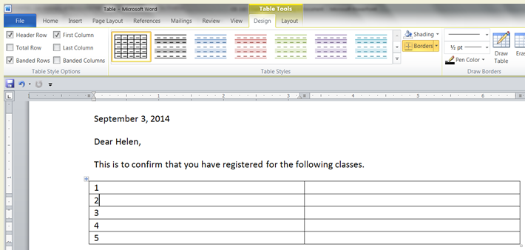
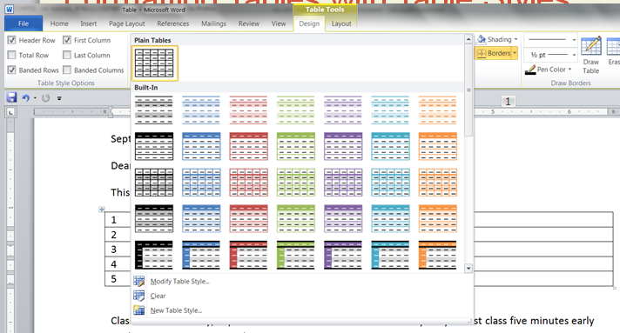
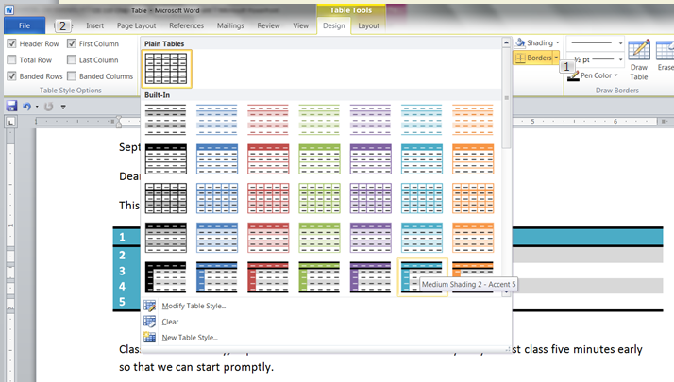
Formatting Tables with Table Styles
More Button

Slide 15
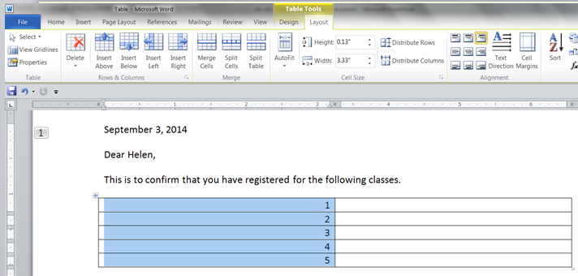
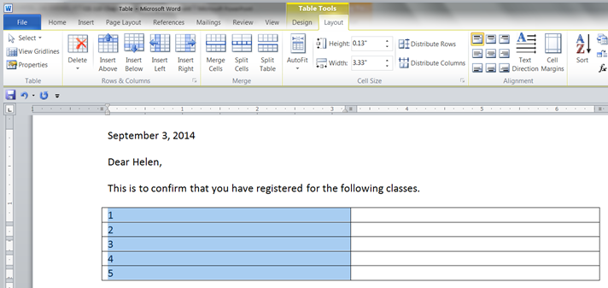
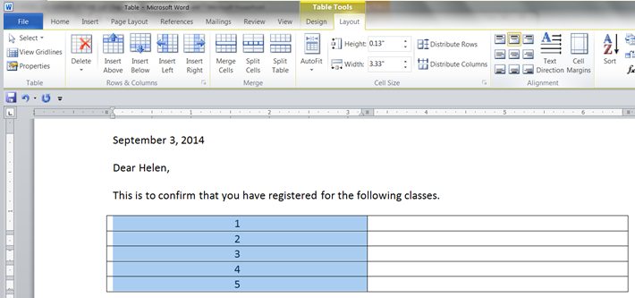
Aligning Tables and Text in Tables
You can change the alignment of text in cells and you can change the alignment of the entire table.

Slide 16
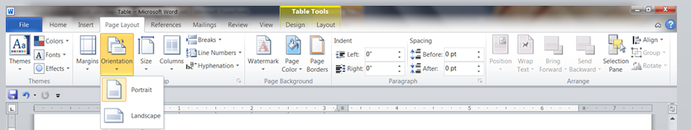
Changing the Page Orientation
Page orientation is the way a page is turned
Portrait orientation The layout of a page taller than it is wide.
Landscape orientation The layout of a page wider than it is tall.
You can easily change the orientation of a document using the Orientation button in the Page Setup group on the Page Layout tab.

Slide 17
Working with Document Sections
Topics Covered:
Inserting a Section Break
Formatting a Section Differently from the Rest of the Document
Adding Different Headers and Footers in Sections
A section - part of a document that can have its own page level formatting and properties.

Slide 18
Inserting a Section Break
To insert a section break, use the Breaks button in the Page Setup group on the Page Layout tab to select the type of section break you want to insert.
Section break - a formatting mark in a document that indicates the start of a new section.

Slide 19
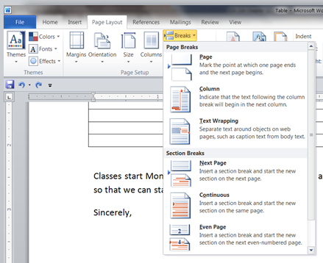
Inserting a Section Break
Next Page—inserts a section break and forces a new page to start after the section
Continuous—inserts a section break without starting a new page
Even Page—inserts a section break and forces a new page to start on the next even-numbered page
Odd Page—inserts a section break and forces a new page to start on he next odd-numbered page

Slide 20
Formatting a Section Differently from the Rest of the Document
Once you have inserted a section break, you can format each section separately.
One of the advantages of dividing a document into sections is that the headers and footers in each section can differ.

Slide 21
Inserting and Modifying Graphics
Topics Covered:
Inserting Clip Art
Examining a Selected Object
Resizing a Graphic
Cropping a Photo
Formatting a Picture

Slide 22
Graphics
A graphic is a picture, shape, design, graph, chart, or diagram.
An object is anything in a document or other file that can be treated as a whole.
Graphics are saved in a variety of file types.
Graphics can be defined as
A bitmap - a grid (or “map”) of square colored dots that form a picture. The colored dots are pixels.
A vector graphic is composed of straight and curved lines and is stored as a mathematical formula.

Slide 23
Graphics File Types
Windows Bitmap
bmp
bitmap
Graphic Interchange Format.
gif
bitmap
Portable Network Graphic
png
bitmap
Joint Photographic Experts Group
jpg
bitmap
Complete list on page 398 of book

Slide 24
Clip Art
Clip art can be electronic illustrations, photographs, video, and audio stored in collections so that you can easily locate and insert them into documents
A small collection of clip art is installed on your computer with Office.
You can also download more clip art from the Microsoft Web site, Off ce.com.

Slide 25
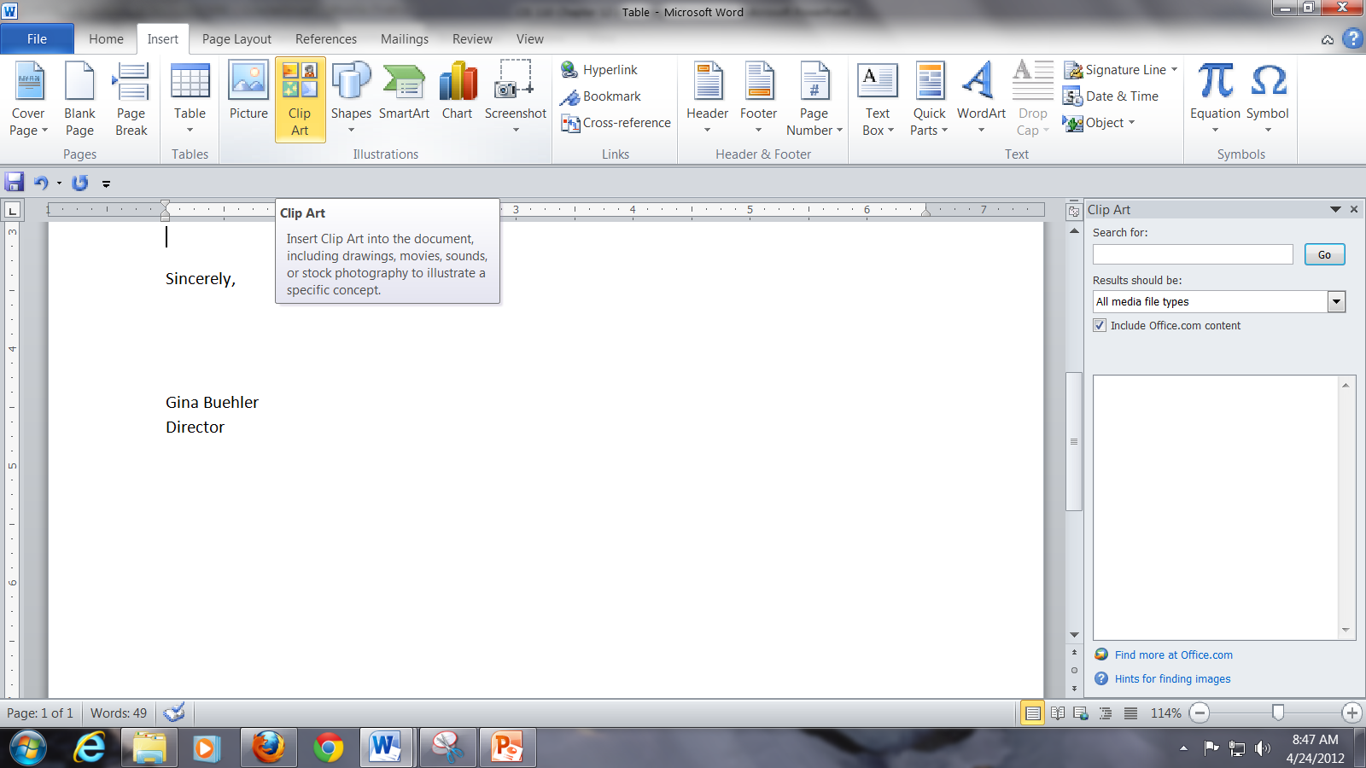
Inserting Clip Art

Slide 26
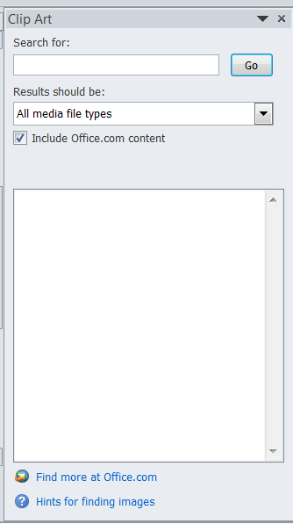
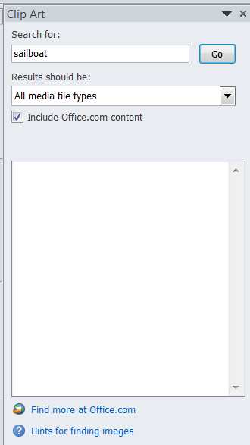
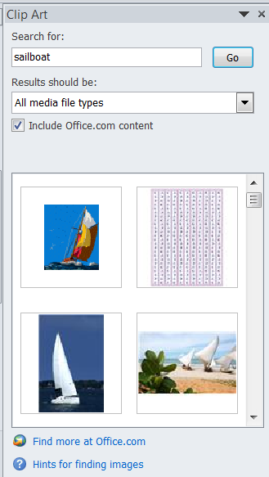
Inserting Clip Art

Slide 27
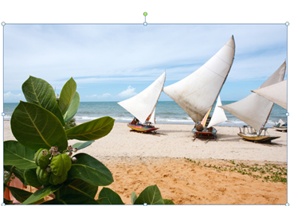

Selecting an Object
A Sizing handle is a small circle that appears at the corner of a selection box or a square that appears on the side of a selection box.
To work with or delete any object in a document, such as clip art or a table, you first need to select that object by clicking on it.
When most objects are selected, a selection box surrounds the object.

Slide 28
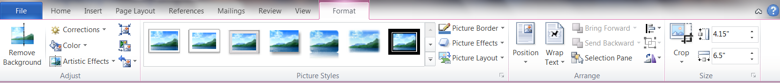
Examining a Selected Object
When you click on object such as clip art or an image the Picture to Format menu appears

Slide 29
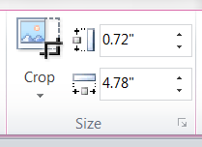
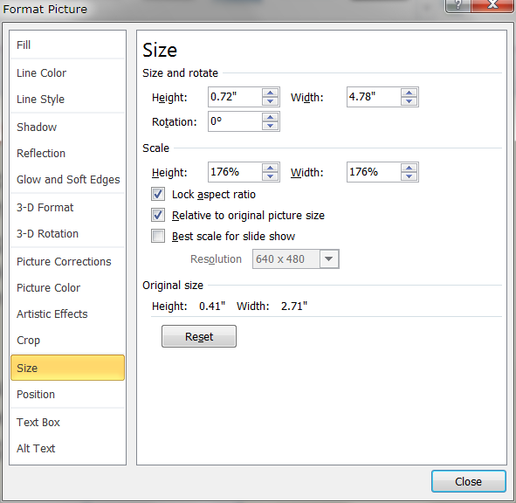
Resizing a Graphic
You can change the size of graphics by
drag the sizing handles
Click on the button in the left corner of the Size section group,
the Format Picture – Size dialog box opens
To maintain the graphic’s aspect ratio (The proportion of an object’s height to its width), drag a corner sizing handle to resize it.

Slide 30

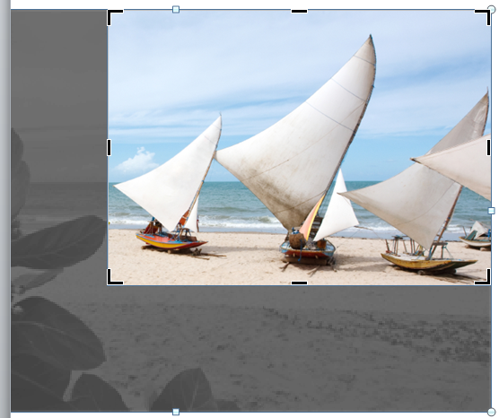

Cropping a Photo
If you want to cut off part of a photo, you can crop it.
To crop a picture
Click on the Crop button in the Size section group
Point to one of the crop handles around the edge of the image The pointer changes to a T handle
Drag the T handle to crop the image.
Click outside of the image area and the image crop will appear.

Slide 31
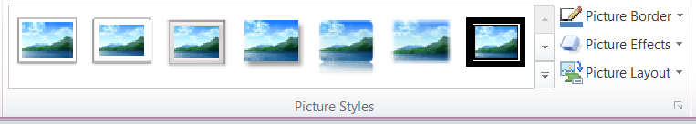




Formatting a Picture
Like text and tables, pictures can have a style applied to them.
To add styles you use the Picture Styles section of the format tab.
There are many style possibilities.

Slide 32
Adding WordArt
WordArt is formatted, decorative text that is treated as a graphic object.
Topics Covered:
Inserting WordArt
Formatting WordArt

Slide 33
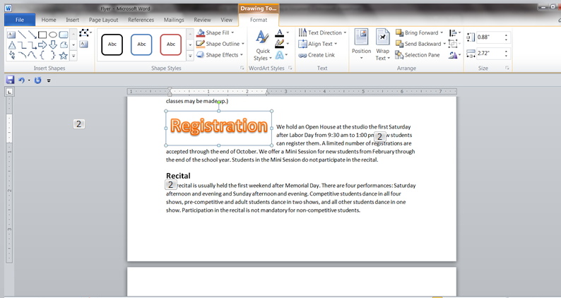
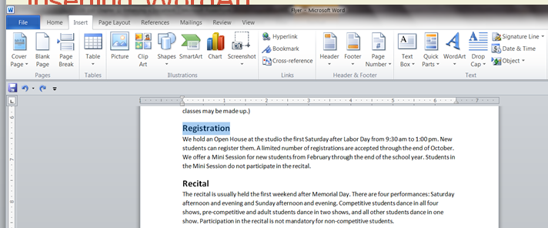
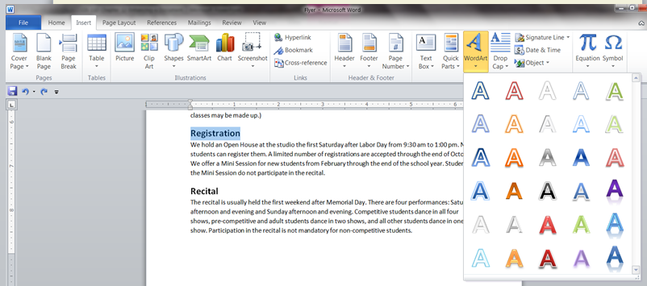
Inserting WordArt
You can create WordArt out of existing text in a document by
Selecting the text group
Clicking the WordArt button in the Text group on the Insert tab
And then selecting a WordArt style from the gallery that opens.

Slide 34
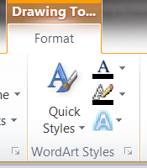
Formatting WordArt
The WordArt Styles group on the Drawing Tools Format tab includes four tools that allow you to alter the color, shape, and overall look of WordArt.

Slide 35
Wrapping Text Around Graphics
Topics Covered:
Changing Text Wrap Properties
Moving Graphics

Slide 36
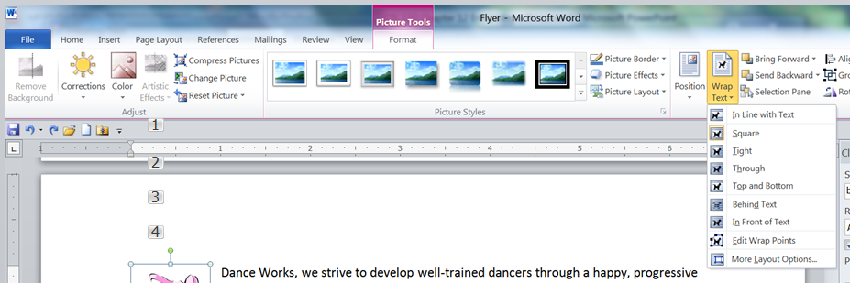
Wrapping Text Around Graphics
To access the text wrap options
click on the image
Select the Wrap Text button
and select either inline or one of the nine text wrapping options.

Slide 37
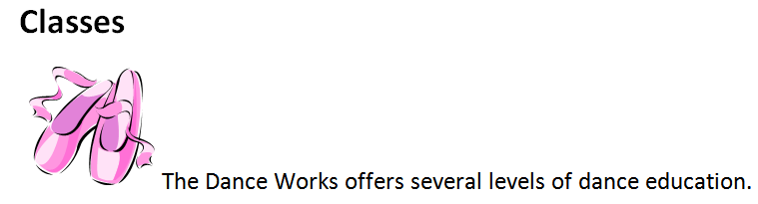
Wrapping Text Around Graphics
Graphic objects within a document can be inline - positioned in a line of text and moves along with the text

Slide 38
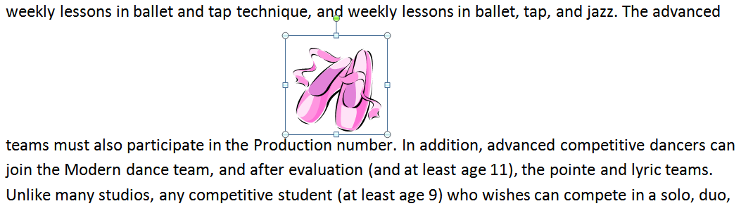
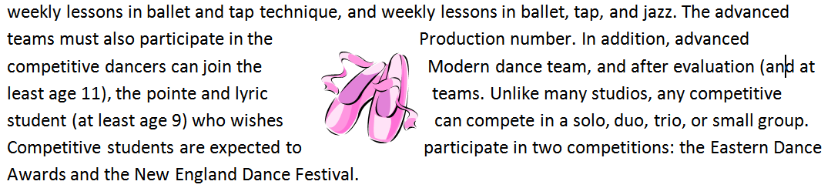
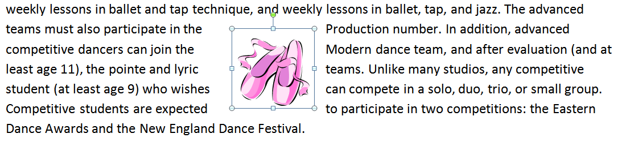
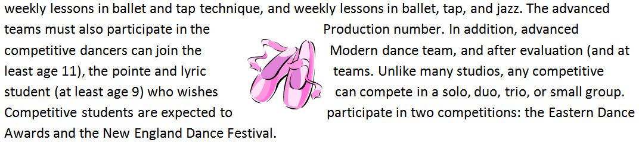
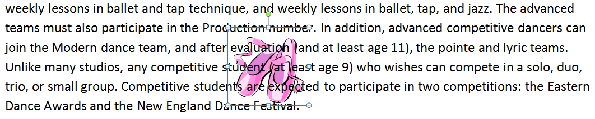

Wrapping Text Around Graphics
floating positioned anywhere in a document.
Square—Text flows around the straight edges of an object’s border.
Tight—Text flows around the contours of the object itself.
Through—Text flows around the contours of the object itself and also fills any open spaces in the graphic.
Top and Bottom—Text stops at the top border of an object and resumes below the bottom border.
Behind Text—Text flows over the graphic.
In Front of Text—Text flows behind the graphic.

Slide 39
Anchors
All floating graphics are attached, or anchored, to a paragraph.
If you move the paragraph to which a floating graphic is anchored, the graphic will also move.
To move a graphic, you drag it to its new position.

Slide 40
Working with Columns
Topics Covered:
Creating Columns
Balancing Columns

Slide 41
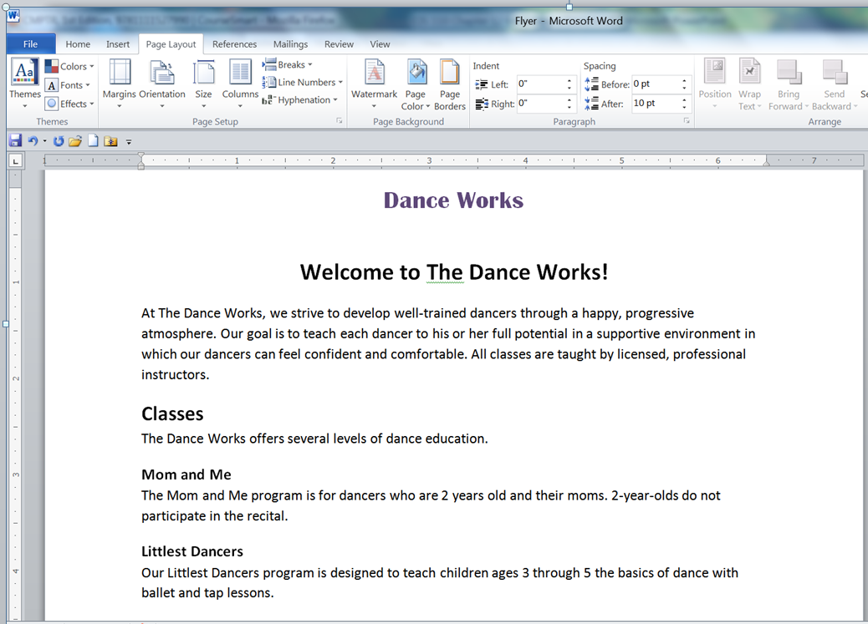
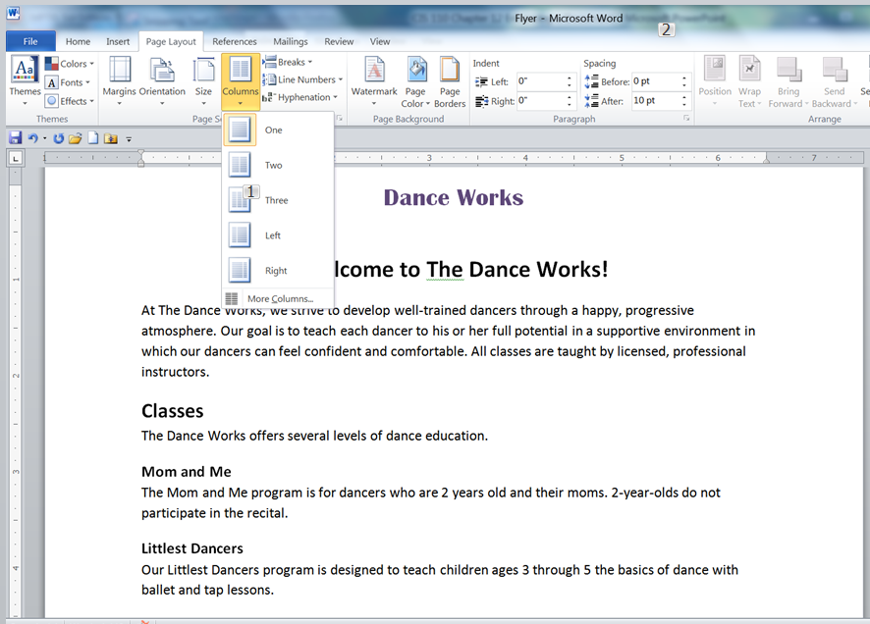
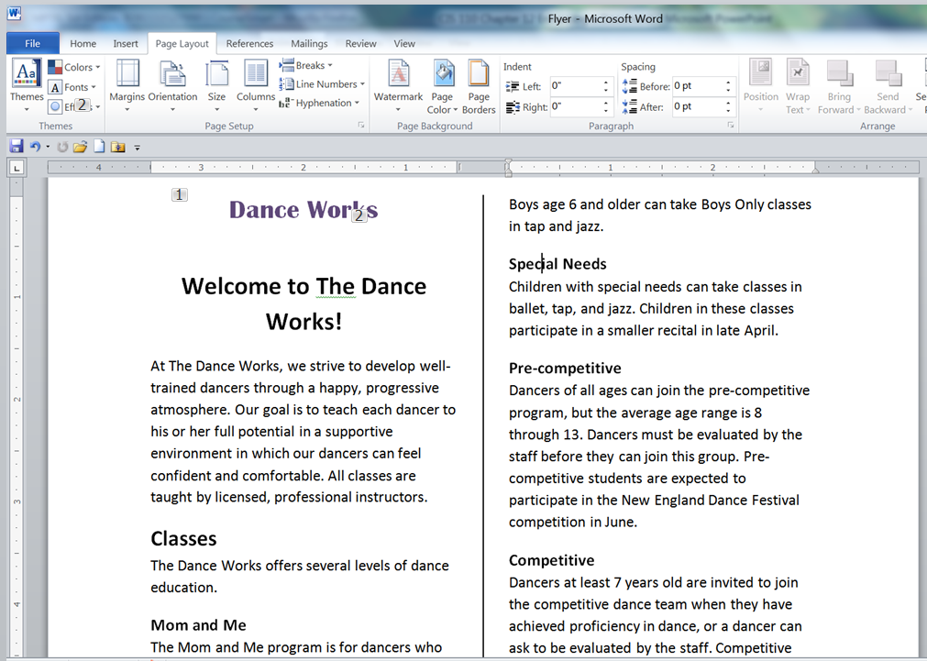
Creating Columns
From the list that appears select the number of columns you want
Start by click on the Columns Button

Slide 42
Creating Columns
You can format an entire document or only a section of a document in columns.
Balancing columns—that is, making the columns on pages in a section the same length—creates a professional-looking document

Slide 43
Working with Building Blocks
Topics Covered:
Creating Quick Parts
Inserting Quick Parts
Managing Building Blocks

Slide 44
Building Blocks
Building block A part of a document that is stored and reused
Quick Part is a building block stored in the Quick Parts gallery.

Slide 45
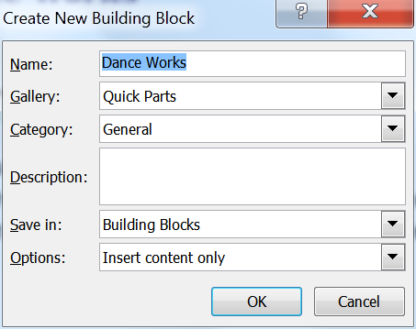
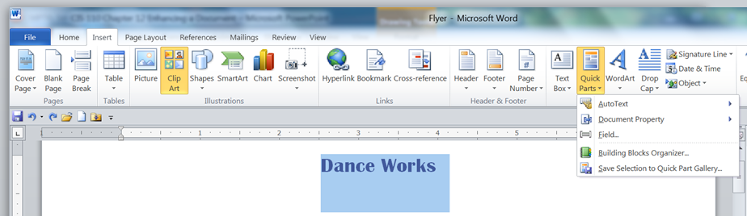
Creating Quick Parts
To create a Quick Part
select the formatted text you want to save
click the Quick Parts button in the Text group on the Insert tab
click Save Selection to Quick Part Gallery. In the Create New Building Block dialog box that opens, you can type the name of the Quick Part.

Slide 46
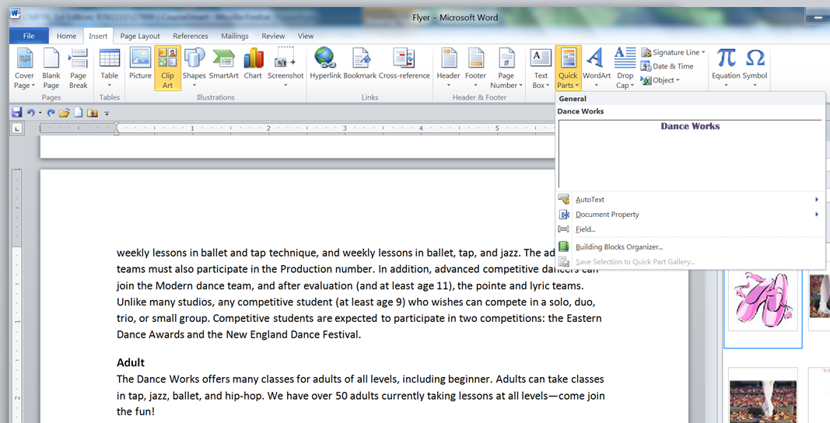
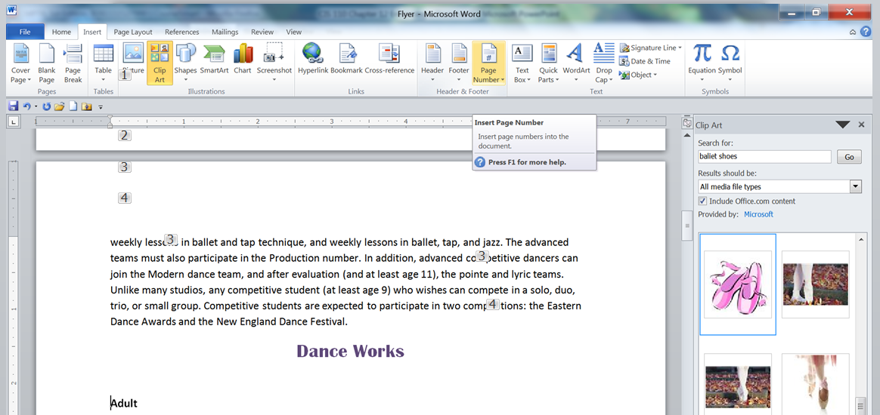
Inserting Quick Parts
Once you’ve created a Quick Part, you can insert it in documents. To do this
Select the Insertion point for the quick part.
Click on the Quick Part button
Select the Quick Part form the list.

Slide 47
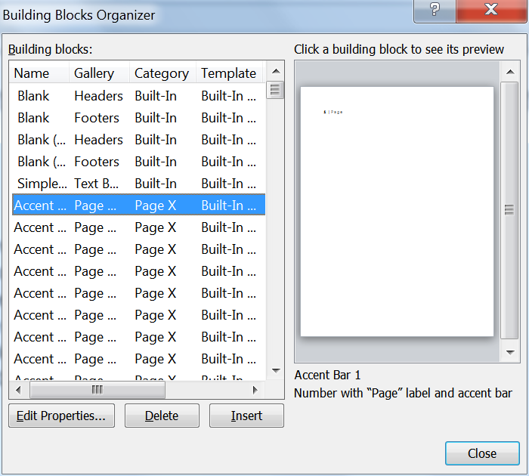
Managing Building Blocks
The Building Blocks Organizer dialog box lists all of the building blocks in the global Building Blocks template and in the current template.

